Slide 1
Strategies for biogas production, upgrade and application in the context of EU bioeconomy
Bio Natural Gas Summit, Sino – EU 2016, Bejing, China

Slide 2


Who is speaking
EUBIA
The European Biomass Industry Association
Supporting Biomass Sector at all Levels
EUBREN
The European Biomass Research Network
Researching for Bioeconomy

Slide 3

A MULTI-FACETED SUPPORT
A business
facilitator
International Projects developer
Identification of competitive projects
Markets potentials evaluation
Creator of Business opportunities
Technical consultancy
More than 50 EC projects experience
Coordinator/Partner in technical tasks, policy and market assessment,
Supporting Dissemination
Information
provider &
diffuser
Organizer of workshops, training events
International conferences supporter
Policy Measures Position papers
Dissemination opportunities
Legal framework barriers identification
Notes:
EUBIA’s central concept is to provide:
- information,
- guidance, expertise and contacts to bio-energy projects and
- business opportunities in the wide biomass sector.
EUBIA objective is to promote the use of biomass, developing innovative bio-energy concepts and increasing the competitiveness of the European biomass industry.

Slide 4
State of Biogas production and upgrading in European countries

Slide 5

EU GHG emission reduction targets
a 40% cut in greenhouse gas emissions compared to 1990 levels
at least a 27% share of renewable energy consumption
at least 27% energy savings compared with the business-as-usual scenario
A reformed EU emissions trading scheme (ETS)
New indicators for the competitiveness and security of the energy system, such as price differences with major trading partners and interconnection capacity between EU countries

Slide 6


Waste streams processed in European AD plants
Sewage sludges from Municipalities & Industry
Sewadge sludge treatment
Landifll and Municipal organic waste
Treatment of organic MSW
16%
12%
72%
Valorization of Agricultural Residues
Animal manure, crops and straw treatment
EU Anaerobic Digester

Slide 7
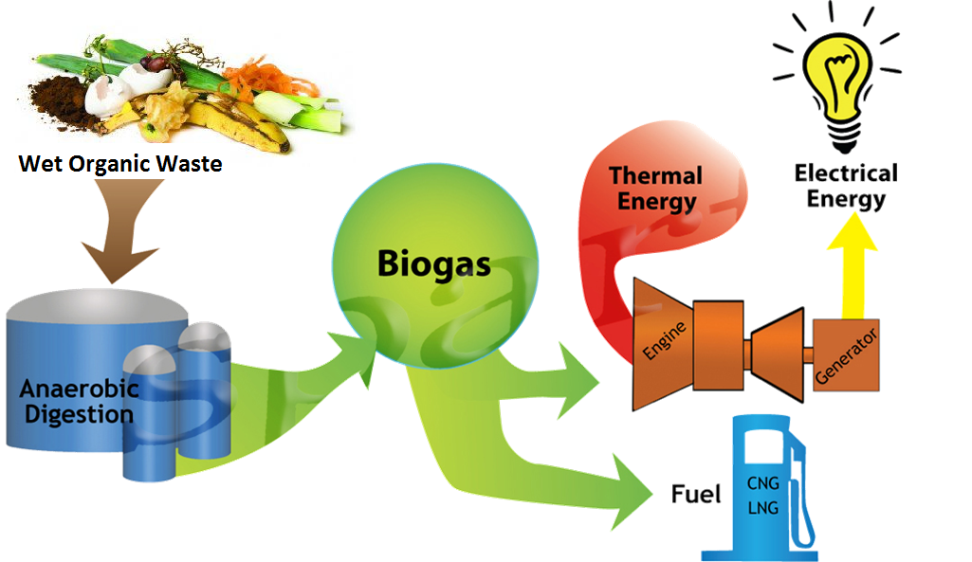
The European Biogas Sector at a glance
8,339 MWel
13,100
MWth
367 upgrading plants
17,240
Biogas plants in Europe
310,000 m3/hour of biogas upgraded

Slide 8
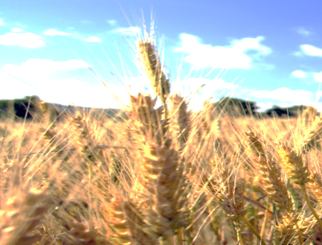




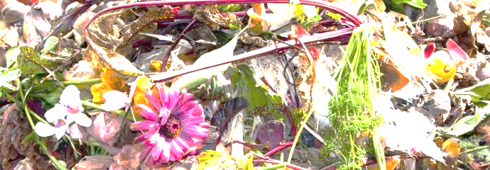

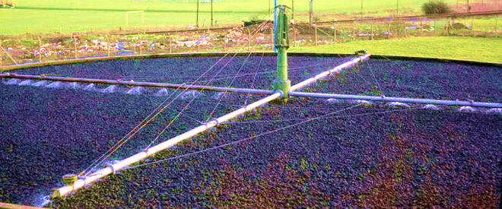


How Biogas is produced by Country
Germany
Italy
Czech Republic
Austria
Producers of biogas from agricultural sources: 87%, 80%, 69% and 46% of their biogas plants operated with agricultural feedstock
France
Produces biogas mainly from organic waste and on landfills
Switzerland
United kingdom
Switzerland and UK extracts biogas mainly from sewage sludge

Slide 9
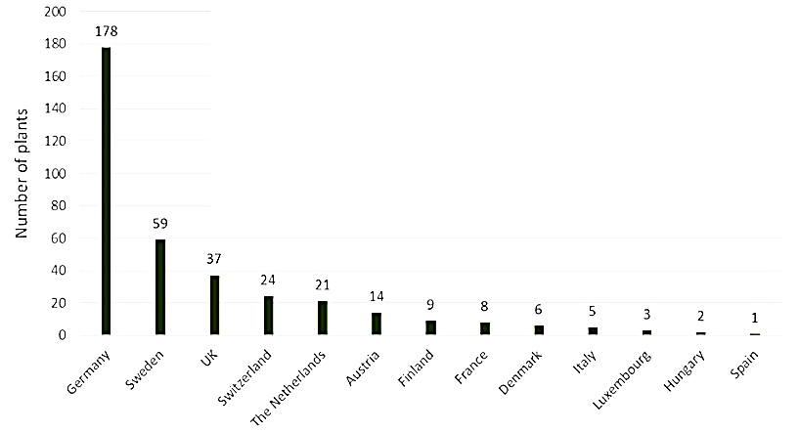

Biogas upgrading to Biomethane in Europe
A steady increase can be appreciated in the biomethane sector (87 new biogas in 2014)
Sweden is leading the use of biomethane in transport: the country dedicated 78% of its 1,303 GWh production to fuel almost 50,000 vehicles.

Slide 10
Why upgrading Biogas into Biomethane
Incomes obtained by biogas utilization in CHP engines for electricity production are uncertain and related to MS applied feed in tariffs
Bio-electricity produced represents only the 35% of the energy contained in the biogas.
Biogas upgrading recovers 95-98% of the total biogas energy content (incentives on biomethane can be higher)
European commission is fostering the utilization of biomethane as vehicle fuel to reduce GHG emission in transportation sector
Biomethane injection in national grids increases the energy efficiency
Now Biogas upgrading technologies are more competitive an highly efficient
Most of EU member states provide the biomethane injection to the national grid

Slide 11
Overview on different Biogas plants for energy production and upgrading to biomethane in EU

Slide 12
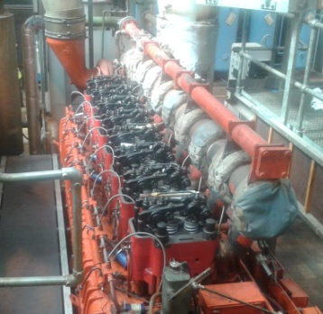
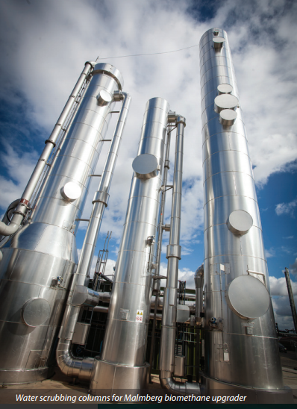
Sewage sludge treatment plant: Minworth STW - Sutton Coldfield, UK
Main Target: Water treatment and disposal
Treats sewage sludge of 1.7 million people
4,000 cubic meters/hour of biogas produced
Biogas utilisation strategy until 2011
9 CHP engines
20 Gwhel. exported
56 GWhel. produced
About 40 GWh of heat losses
New biogas upgrading solution adopted
1200 m³/h biogas upgraded -> 720 m³/h of Bio Natural gas produced
2800 m³/h biogas processed in CHP engines
40 GWhel produced per year
65 GWh of Bio Natural gas injected to the grid

Slide 13
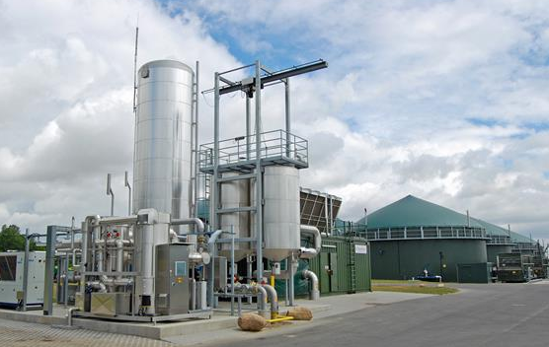
Maize and sugar beet pulp treatment plant: Rackwitz - Germany
Mai target: Gas production
12.2 million m3 of biogas produced/year
Gas upgrading capacity of 1,400 m3/h
6.7 million cubic metres of Bio Natural Gas produced per year
4 Primary Anaerobic digesters fermenters
2 secondary anaerobic fermenters
5 Digestate storage tanks
Sugar crops processing: Very quick digestion and very homogenous substrate

Slide 14
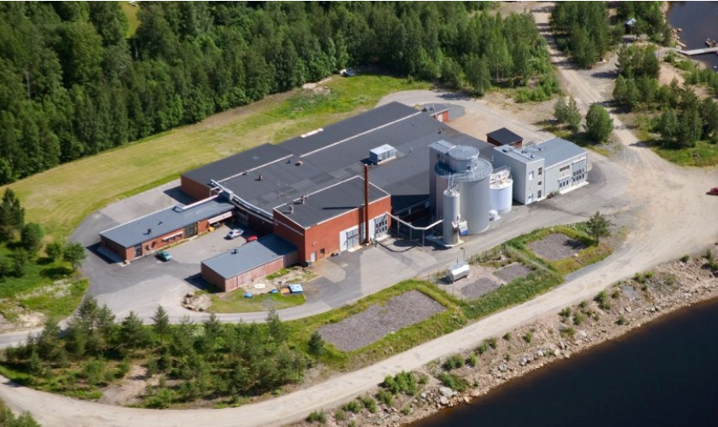
Food waste and sewage biomethane plant – Sweden
Main target: Waste treatment and energy efficiency
1,200 tons Food waste & 24,000 m³ sewage (4% dry) per year
First plant built in Sweden which had to deal with methane leaks (3%).
600,000 Nm3 of Bio Natural gas produced annually (water wash upgraded)
1 Digester volume 1,300 m3
55°C process temperature
1600 t/year digestate
6 Million € total investment costs
Main issues: gas distribution, compression and transportation

Slide 15
Main issues related to Biogas upgrading to Bio-methane

Slide 16
Biogas upgrading to Bio methane: Most used technologies in EU
The most significant technologies in European region at present are:
water scrubbing - WATS
pressure swing adsorption - PSA
chemical scrubbing - CHEMS
physical scrubbing - PHYS
Membrane separation - MEMS
TECHNOLOGY | H2S removal | Pressure | CH₄ yield | CH₄ purity | gas flow capacity (m³/h)
water scrubbing | Not needed | 6 to 12 bar | 94% | 98% | 500-2000
Pressure swing adsorption | Not needed | 4 to 10 bar | 91% | 98% | > 2000
chemical scrubbing | Needed | 1 atm | 90% | 99% | 500-1000
physical scrubbing | Not Needed | 7 to 8 bar | 90% | 94-98% | 500-2000
membrane separation | Not needed | 20 to 36 bar | 78% | 97-99.5% | <300

Slide 17
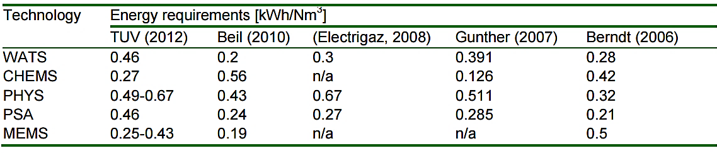
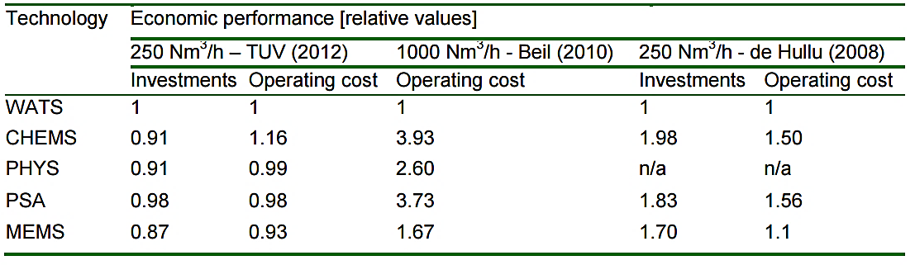
Energy consumption and costs of Biogas upgrading technologies
The most preferable technology is WATS with almost 40 % share, followed by PSA and CHEMS (both around 25 % share).

Slide 18
A high investment
The economic bottleneck of Biogas upgrading facilities
Upgrading biogas in small scale biogas plants (150-300 Nm³/h) doesn’t give a valid payback time as both investment and operational costs are too high.
There is a large amount of small scale family farms in Europe
For a plant treating 2,000 Nm³ biogas/h the costs are 1,500 €/Nm³ and for a plant treating 500 Nm3 biogas/h the costs are on average 2,000 – 2300 €/Nm³
According to AEBIOM (2013), CHP engine processing about 500 Nm³/h biogas costs around 600-650 €/kWe, which means:
590-650,000 €
According to Urban (2009) the investment costs for a biogas upgrading plant treating 500 Nm³ biogas/h are on the average 1,000,000 €
The economies of scale favour larger biogas plants where the desired scale should be between 500 and 1,400 Nm³/h of raw biogas.

Slide 19
The great Bottleneck: Digestate disposal and reutilization

Slide 20
Digestate disposal & treatment costs
Nitrate directives represent problem all around Europe. Digestate disposal is a bottleneck due to exceeding nitrogen (and ammonia) and heavy metals content.
Digestate tratment requires high amount of energy and represents one of the most relevant costs.
Digestate treatment and disposal costs in Europe start from 15 €/ton
the digestate treatment would allow to have a good biofertilizer to be also traded among other farmers for bio-food production.
Digestate upgrading would be beneficial for:
Phosphorus recycling
Organic Nitrogen input
Avoid soil erosion
Reduce synthetic fertilizers GHG emission

Slide 21

Digestate disposal & treatment costs
Nitrate directives represent problem all around Europe.
Digestate disposal is a bottleneck due to exceeding nitrogen content and heavy metals content.
High Disposal costs:
More than 15 €/ton!
Digestate tratment requires high amount of energy and represents one of the most relevant costs.
Governments do not provides adequate laws or standards for biofertilizer from digestate substrate, still considered as waste.
Electricity for sale
Heat
savings
Electricity savings
Grid connection
Annual costs
Investment
Digestate treatment

Slide 22

Digestate recycling for biofertilizer production
Digestate treatment would produce valuable biofertilizer (3-4% N _{db} content, 60-80 % Ammonia).
Biofertilizer low price:
100 €/ton!
Electricity savings
Heat
savings
Grid connection
Supported as carbon saving product.
Promoted as valuable green fertilizer for increasing food quality.
Considered as co-product to increase biogas economic feasibility
Savings on digestate disposal and on artificial fertilizers
Electricity for sale
Biofertilizer for sale
Investment
Annual costs

Slide 23
Upgrading digestate into high value products:
EUBIA European co-funded projects

Slide 24


Sustainable techno-economic solutions for the agricultural value chain
Agrocycle activity on digestate application as biofertilizer:
Assess environmental impacts of agricultural waste materials and biofertilisers, especially on water quality
Formulate farming practices recommendations and guidelines concerning the use of new biofertilisers
Evaluate the effectiveness of anaerobic digestates from different waste materials
Assess the agronomic performances and the soil fertility effects of anaerobic processed slurries in comparison with commercial fertilizers and composted municipal organic wastes from separate collection, on different crops
Application of anaerobic digestate obtained from cattle slurry to organic vegetable crop rotations

Slide 25


SaltGae suite of technologies, combining aerobic and anaerobic processes for biogas production with ponds hosting synergistic mixtures of halotolerant bacteria and algae, will treat Waste water saline effluents resulting from three different production processes:
Tannery: (~40 g/L salinity),
Whey (~10 g/L salinity)
Aquaculture (~3 g/L salinity),
Three different pilot plants operating:
Slovenia,
Italy
Isreal

Slide 26

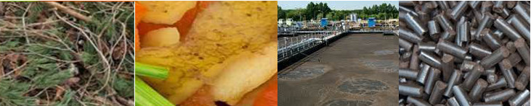
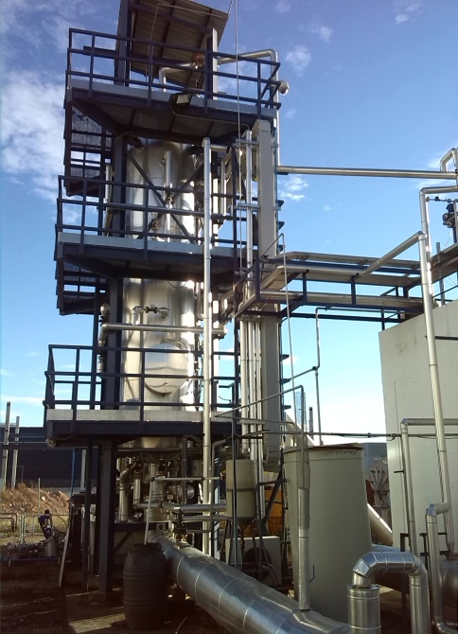
New technological applications for wet biomass waste stream products
Hydrothermal Carbonisation (HTC)
Organic substrate is milled and mixed with water, as the substrate is injected in liquid status, with moisture content from 60 to 85%.
Biomass is exposed to around 180-210 °C and 16-20 bars, converted into a main product a coal-water-slurry. After water separation, there main products are:
A coal-like product (HTC carbon) and a water phase rich in nutrients, sugars and organic acids (from 5 to 35%).

Slide 27
Thank you for your attention!
Andrea Salimbeni
EUBIA Project Manager
andrea.salimbeni@eubia.org
Skype: a_salimbeni

