Slide 1

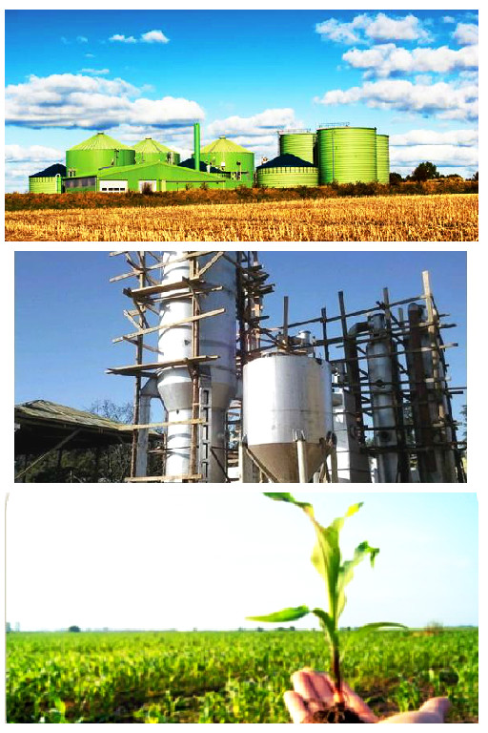
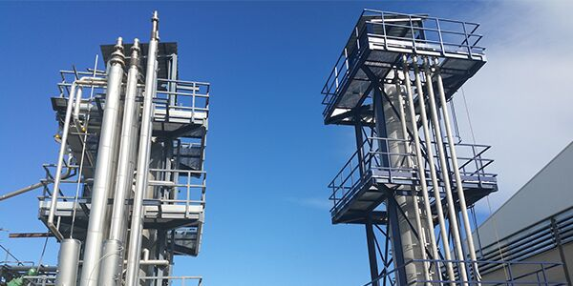
Exploring different organic waste valorisation strategies: From fresh material to power
WBP – 29 March 2017, Amsterdam, NL
Presented by Andrea Salimbeni

Slide 2
Table of content
World Bioenergy market outlook
Biomass residues availability, quality and future market
New Technologies and strategies for sustainable BioPower
Ongoing projects and future activities
Conclusions

Slide 3
World Bioenergy market outlook
INDICATORS | 2020 | 2030 | 2040 | 2050
GDP Growth (%/yr) | 2,7 | 2,9 | 2,5 | 2,6
Population (millions) | 7.655 | 8.320 | 8.873 | 9.305
GHG EMISSIONS | 2020 | 2030 | 2040 | 2050
CO2 Billion t | 45,7 | 52 | 57,4 | 60,9
CH4 (Mt) | 396,9 | 640,8 | 678,3 | 713
N2O (Mt) | 11,21 | 14,48 | 16,35 | 18,36
LAND USE (Mha) | 2020 | 2030 | 2040 | 2050
Cropland | 2003,9 | 2239,5 | 2463,6 | 2659,9
Pasture | 2798,8 | 2730,3 | 2680,1 | 2631
Natural grassland | 594,7 | 560,7 | 534,9 | 524,2
Natural & managed forests | 4649,3 | 4505,3 | 4369,5 | 4240,8
TOTAL | 12.9 | 12.9 | 12.9 | 12.9

Slide 4
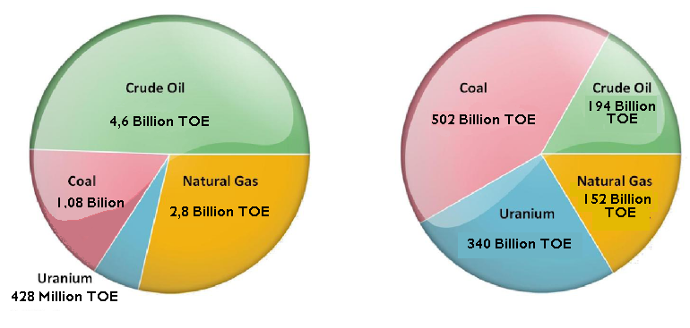
World’s total fossil fuel reserves
a
b
World’s total consumption (a) and estimated total reserves (b) of Oil, Natural Gas, Coal and Uranium. Source: BP Statistical Review of World Energy June 2012 Adapted by EUBIA
Non conventional oil and gas resources
Oil from sands: huge new resources (i.e. Texas)
Nat. Gas from rocks: 470 x 10¹² m³
Methane-hydrate: 100 - 500 x 10¹² m³

Slide 5
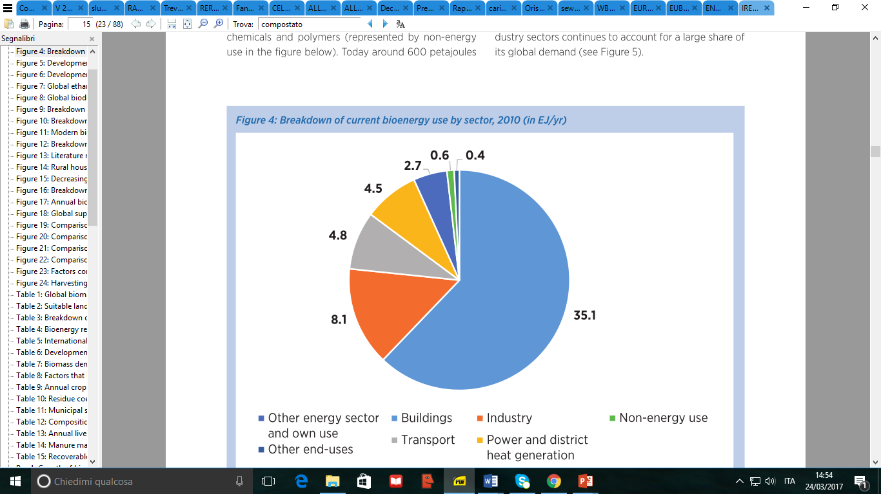
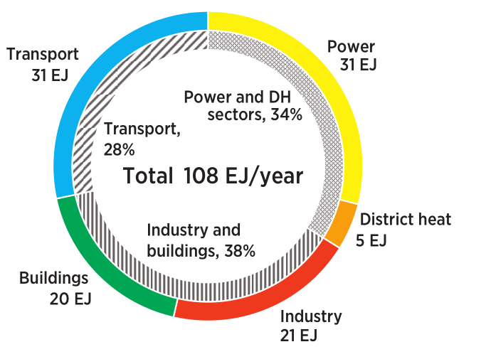
Biomass and Bioenergy global demand
Global biomass demand could double to 108 EJ by 2030
35 EJ would be consumed for heat and power generation
Bioenergy consumption by Sector in 2010
Bioenergy consumption by Sector in 2030
Industry
Buildings

Slide 6
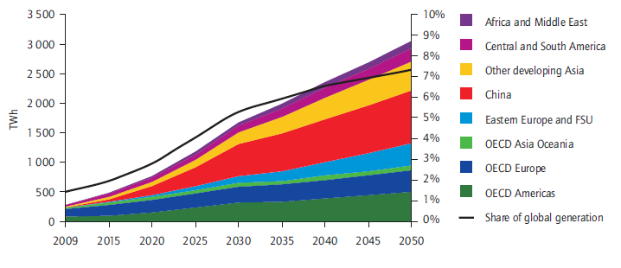

Biomass for Electricity. World future market perspectives
Renewable electricity share will increase from 19% in 2009 to 50-60% in 2050

Slide 7
BioPower sector In Europe: the 40% CO₂ reduction challenge
It is general consensus that Energy and transport sectors are major contributors to the global CO2 emissions registered in EU and worldwide
Thermal power plants emission reduction should pass through:
An increase in energy efficiency
The replacement of fossil coal with renewable carbon sources.
Despite biopower plants could count on a renewable energy source, the neutral carbon balance, usually declared regarding woody biomass based co-firing plants is not always affordable

Slide 8
Innovative biopower generation: The role of residual biomass feedstock
Sustainability of woody biomass use in biopower plants is getting one of the hottest topic in Europe.
The land use change is affected by dedicated wooden forests plantation
The biomass sustainability is reduced in case of wood pellets long distance transportation to EU power plant from non European countries.
Biopower plants operating with biomass residues are considered as the only solution which can be considered to have a negative carbon balance
Power Generation System | CO₂ emission (with no-CCS)
Direct Coal | 847 g CO₂eq. /kWh
Direct Coal NGCC | 499 g CO₂eq. /kWh
Dedicated woody biomass | 49 g CO₂ eq./kWh
Biomass residues | -410 g CO₂ eq./kWh

Slide 9
Biomass residues availability, quality and future market
2

Slide 10
Organic residues energy potential
Organic waste valorisation is a global topic, and a problem to be solved in Asia, Europe, as well as United States, Africa and Middle East countries.
In Europe: More than 269 MTOE of organic residues, of which 140 from Agriculture, 85 from forests and 44 from food industry
In USA: More than 290 MTOE of organic residues, of which 180 from Agriculture, 90 from Forests, and 15 from food
In China: More than 1,48 Billion TOE of organic residues, of which 420 MTOE from agriculture, 520 MTOE from forestry, 500MTOE from sawmills, and 30 from food.
Sewage sludge produced in the above regions amount to 40-55 Million dry tons per year

Slide 11
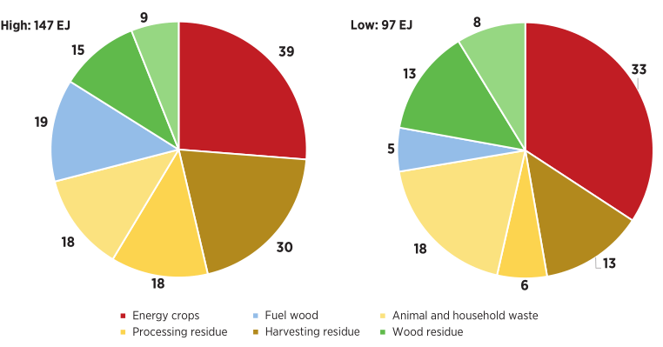
Breakdown of biomass supply potential estimates by type, 2030
The total amount of biowaste material achievable in 2030 is around 2,5-3,5 Billion TOE

Slide 12
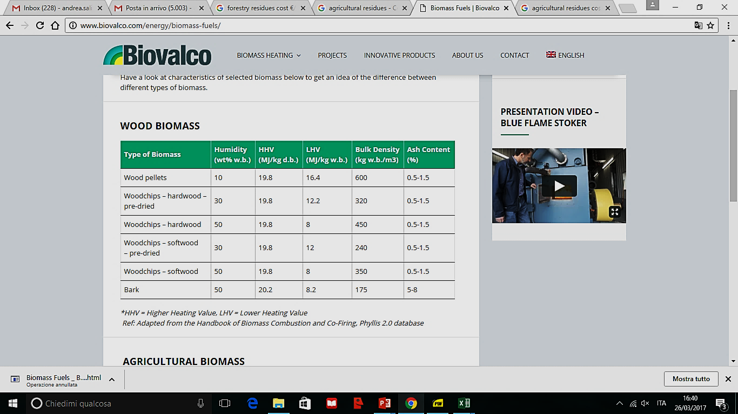
Forestry residues: High quality woody biomass
Woody biomass and forestry residues are the best quality biomass available. However, the bioenergy generation growth is affected by a range of bottlenecks
Forests are limited areas, located only in specific regions (Russia, Sweden, Nigeria).
Transportation can affect the costs and the sustainability of the fuel.
Woody biomass residues are already used when collection is feasible.
D. Most unused residues are left in forests because access is limited and large trucks can’t collect the biomass

Slide 13
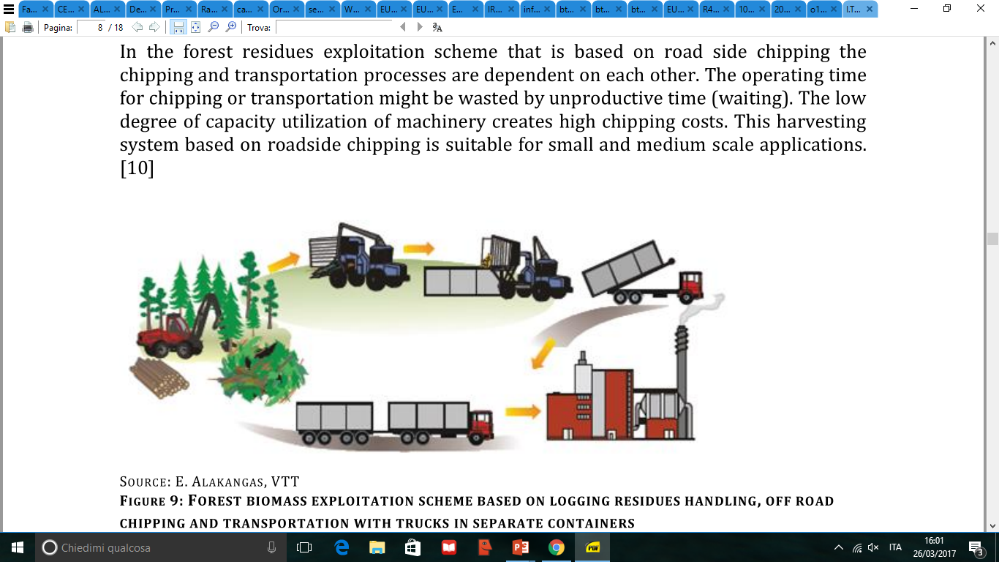
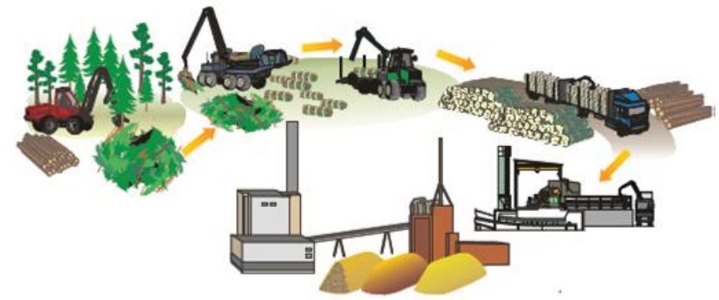
Forestry residues supply: chipping before or after transportation
Logging residues
Forest site chipping
Transport with trucks
Good for large scale
High efficiency
Cost:18-20 €/MWh
Moisture: 25-35%
Logging residues
Transport with trucks
Chipping at end user
Suitable for small scale
Low efficiency
Cost: 22-28 €/MWh
Moisture: 30-40%

Slide 14
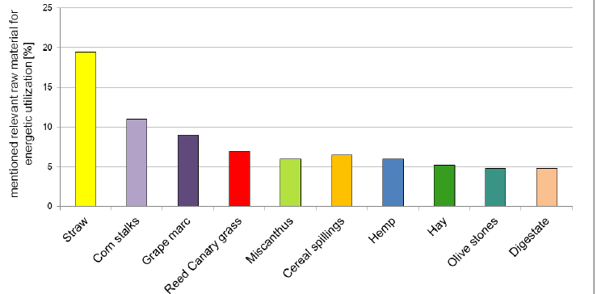
Agricultural residues: a huge resource with the supply chain challenge
Cereals Straw: Most used agricultural residue for energy
Huge availability
Low moisture: 15-20%
Low market cost: 50-60 €/ton
Energy cost: 15 - 17€/MWh
Most used residue for energy in EU
GJ/m3
Disadvantages
Low ash melting point
Chlorine and Alkali in the flue gas
Low energy density
Used for other purposes (fertilizers, animal feed, bedding)

Slide 15
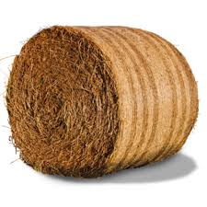
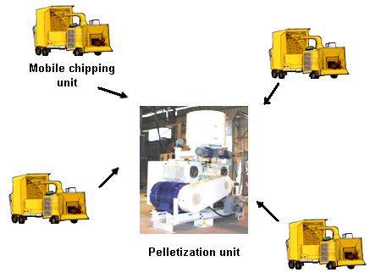
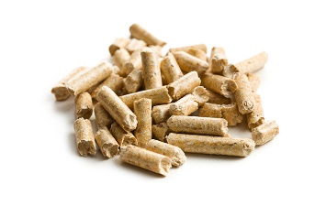
Agriculture residues supply: Bales Vs. agro-pellets
Straw Bale
Transportation
Delivery
Final cost: 60,8 €/ton
50m³ = 8 t = 130 GJ
Cost: 50 €/t
600 km = 0,68 €/GJ
Cost: 10,8 €/t
Pelletization
Agro-pellet
Transportation
Delivery
13m³ = 8 t = 130 GJ
600 km = 0,20 €/GJ
Cost: 2,7 €/t
Final cost: 59,5 €/ton
Cost: 6,8 €/t
Over 600 km distance, pelletization of agriculture residues brings a real advantage

Slide 16
New Technologies and Strategies for Sustainable BioPower
3.

Slide 17
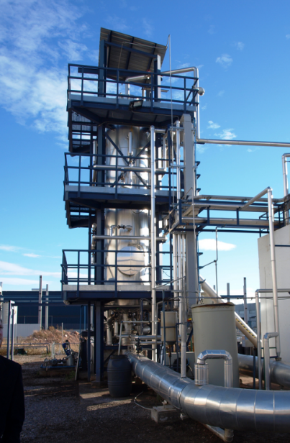
The HTC technology: sustainable upgrading
Hydrothermal Carbonisation (HTC) is an innovative industrial technology which transform organic wet substrates in a carbonaceous material. Organic substrate is milled and mixed with water, as the substrate is injected in liquid status, with moisture content from 60 to 85%.
Biomass is exposed to around 180-210 °C and 16-20 bars, in the presence of water and thereby converted into a main product a coal-water-slurry.
After water separation, two main products are:
    A coal-like product (HTC carbon)
    a water phase rich in nutrients, and organic acids (from 5 to 25%).

Slide 18
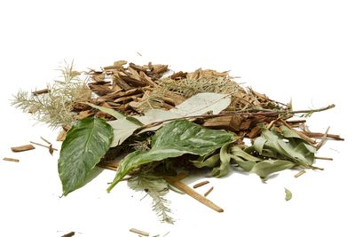
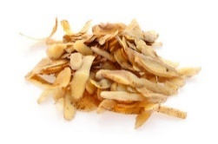
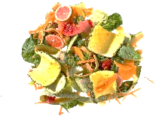
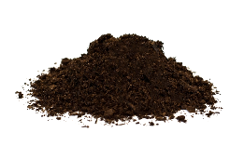
The wide range of organic wastes treatable by HTC
Ingelia HTC facility is able to treat a wide range of substrates
Organic wastes present different quality, composition and market values
The organic waste quality influence the the final cost of the BioCoal
Green Waste. No tipping fee applicable. BioCoal of high quality, with low ash and high LHV.
Industry Food Waste. Homogeneous material. Low or no tipping fee applicable. BioCoal of high quality, reduced ash and high LHV.
Municipal organic waste. Can be of quite good as well as of bad quality. Tipping fee applicable. BioCoal ash content: 8 to 24%.
Sludge. Bad quality product. High tipping fee applicable. BioCoal ash content between 18 to 30%.

Slide 19
Hydrochar as new biofuel commodity
Hydrochar is a carbonaceous product. It can used for direct combustion or at high mixing rate in co-firing plants. Ash melting point: >1100°C
The final pelletized hydrochar market price goes from 80 €/t to a maximum of 190 €/t
It is hydrophobic, therefore it can be stored with no degradation risks
The product has high energy density: 15,4 GJ/m³
Cost: 16-24 €/MWh
Biocoal Ultimate Analysis (% dry basis)
Element | C | H | S | N | Ash | Volatile | Fixed C
Value | 50-63 | 4-6 | 0,1-0,7 | 1-3 | 3-18 | 50-65 | 35-50
The Hydrochar can used as biofuel for energy generation in medium and large scale boilers, co-fired with coal, or at full rate.

Slide 20
Solution for a sustainable bioenergy: The chemical looping combustion
Power Generation System | CO₂ emission no-CCS | CO₂ emission with CCS
Dedicated woody biomass | 49 g CO₂ eq./kWh | -667 g CO₂ eq./kWh
Biomass residues | -410 g CO₂ eq./kWh | -1368 g CO₂ eq./kWh
A fluidized bed chemical looping system composes of a fuel reactor, an air reactor, loop seals, cyclones and a cold trap as shown.
The oxygen carrier particles are mixed with fuel by fluidizing gas for gas/solid fuel combustion in the fuel reactor where Red-Ox reaction occurs:
Reduction: fuel is introduced in a reactor (fuel reactor) where it reacts with an oxygen carrier (MeO_{x})
Oxidation: the reduced metal oxide, Me_{x}O_{y-1}, circulates to a second reactor (air reactor).
The effluent from the fuel reactor consists of mainly CO2 and H2O (steam), and high purity CO2(98%) is yielded.
The steam temperature from fuel reactor is around 970°C.
The exhausted gases temperature in air reactor (re-oxidation) achieves 1050°C

Slide 21
Technical, economic and environmental benefits of Bio - CLC
Low Corrosion - longer life of components
Fine ash from the biomass can be expected to leave the fuel reactor in the gas stream in the form of fly-ash, thus, biomass ash not expected to reach the air reactor, where cooling surfaces are located.
Higher termal efficiency
No corrosion problems of wall tubes due to alkali components in fuel ash steam, higher temperature in comparison with conventional biomass combustion
More sustainable for the atmosphere
No CO₂ emission thanks to the easy pure CO₂ storage and reutilization: a negative CO₂ balance achievable with all types of biomass used, with a very high impact in Global warming reduction. Reduced Nox

Slide 22
Ongoing projects and future activities
4.

Slide 23
EUBIA recently realized on biomass residues valorisation
2013-2016: NEWAPP project - FP7
2011-2015: BioenNW - Interreg NEW
2010-2014: EUROBIOREF – FP7
2012-2014: RecOil – IEE
2011-2013: GERONIMO II-Biogas – IEE

Slide 24


EUBIA ongoing projects on biomass residues valorisation
2016–2019: Agrocycle – H2020 waste. Sustainable techno-economic solutions for the agricultural value chain. Budget: 7,6 M€
2017 – 2020: BioReg – H2020 BB. Absorbing the Potential of Wood Waste in EU Regions and Industrial Bio-based Ecosystems. Budget: 1 M€

Slide 25
5.
Conclusion

Slide 26
A Sustainable Bioenergy Market in 2030
Organic Waste, Sewage Sludge, Agricultural residues
Around 200 Million Tons Oil Equivalent
Hydrothermal carbonisation upgrading
Producing a storable, high energy density biomass commodity
High Energy Efficiency Biopowe plants
CO2 storage and Re-Use, PM efficient precipitation, heat recycling
Reduce 120 million tons of waste landfilling
Remove 47 Billion Tons of CO2 from the Atmosphere

Slide 27


Thank You for your Attention
Andrea Salimbeni
EUBIA AISBL
Scotland House
Rond Point Schuman 6,
B1040, Brussels,
Belgium
T. + 32 2 282 84 40
Email: eubia@eubia.org
www.eubia.org

